Slide 1
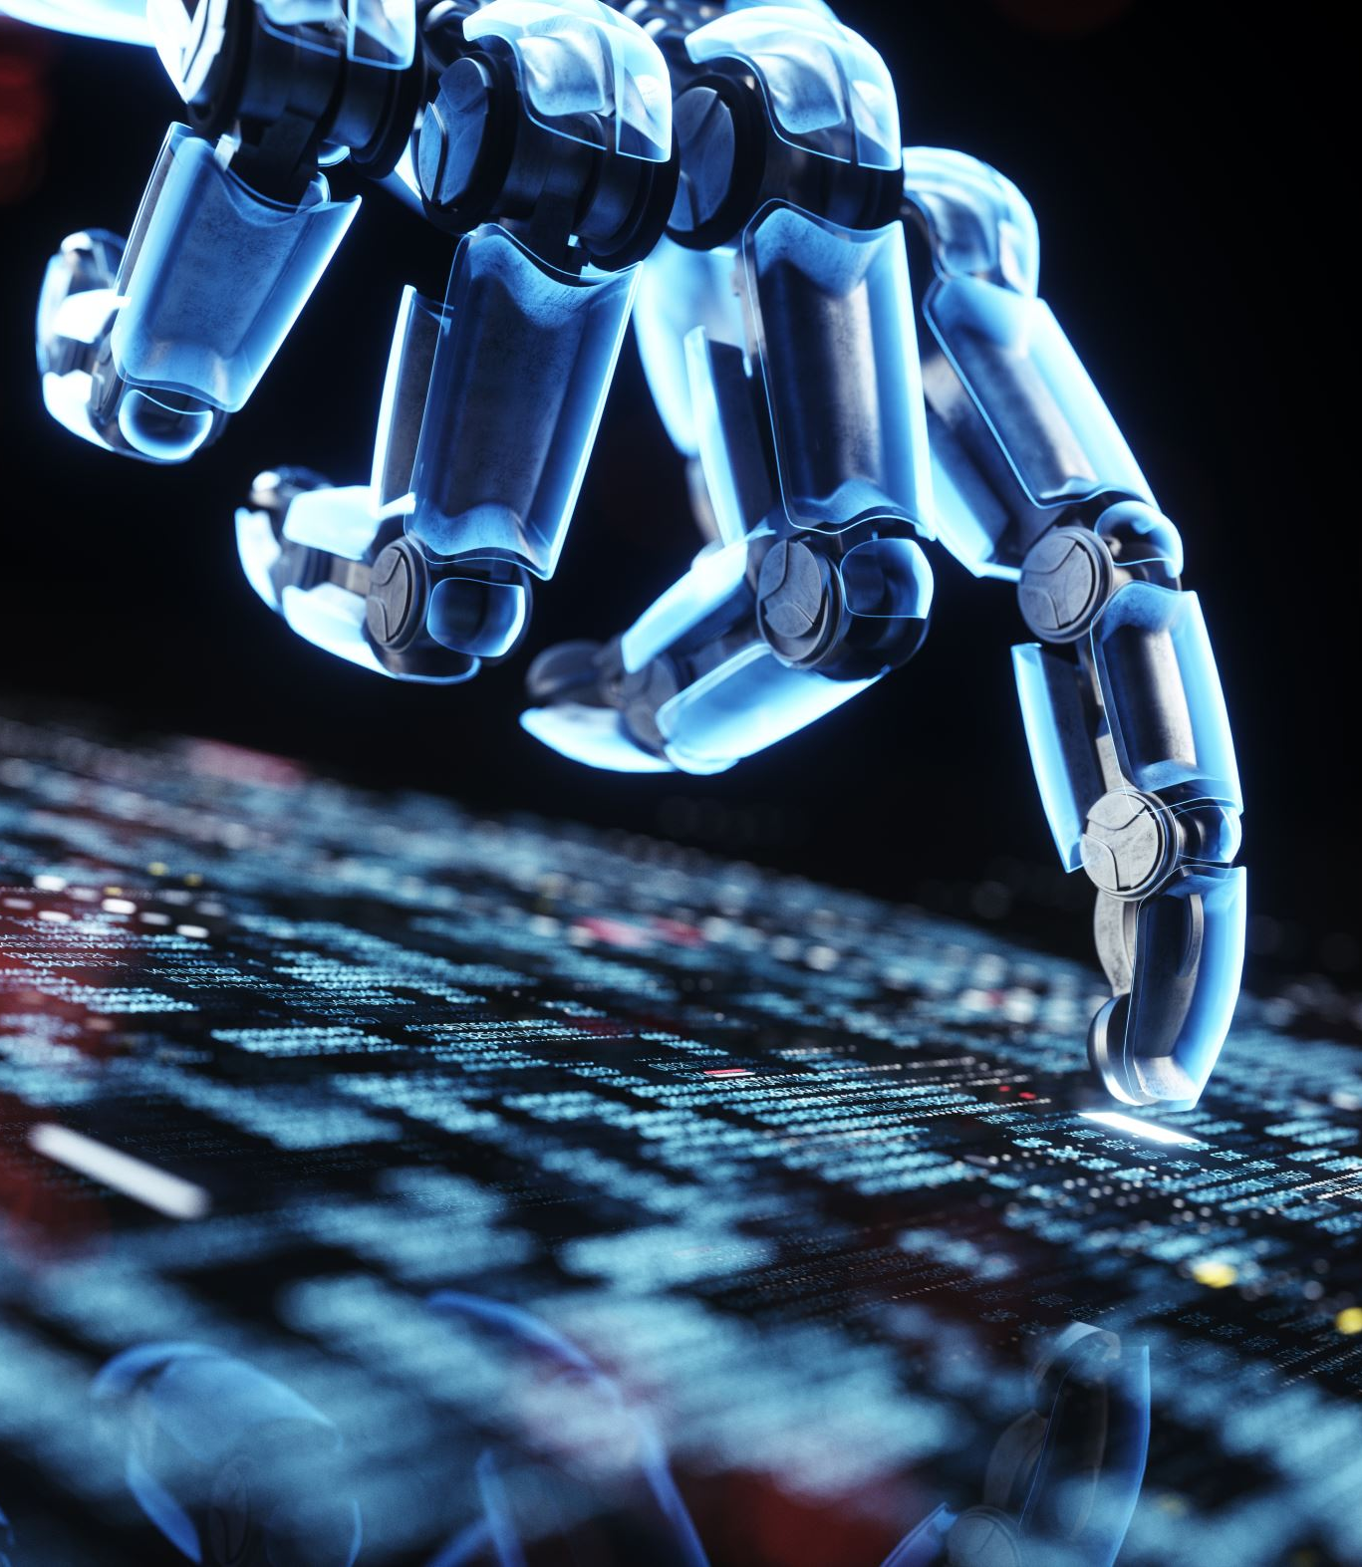
CS5510 Final Project - Ball-Moving Robot
Luke Shumway, Mason Francis, Caleb Jeppson, Matthew Larsen

Slide 2

Problem
Imagine a world where you have a ball over there, and you need it over here
You don’t have the energy to get it
But you do have your CS degree
Have no fear, Raspbot is here!

Slide 3
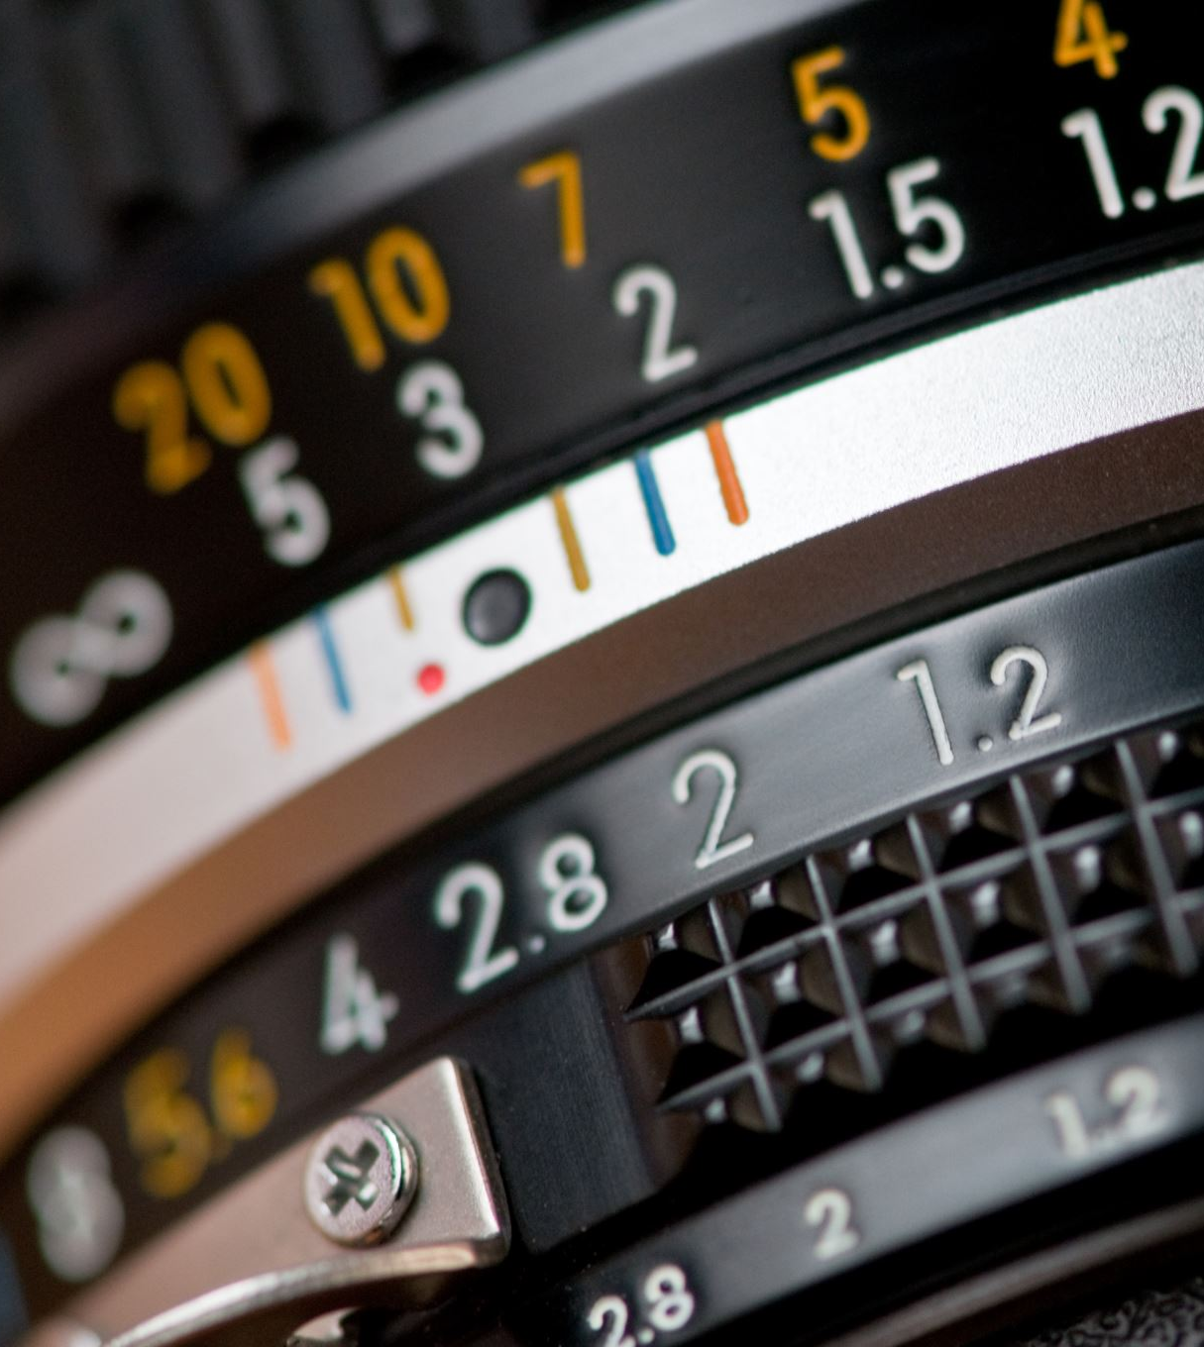
Solution
Camera
Ball Locator
Mapper
Motion Planner
Motor Controller

Slide 4
Challenges
Operating Systems
Wifi Configuration
Sensor calibration
Finding a Ball
Communication

Slide 5
Successes
Operating Systems
ROS2 and Raspberry Pi
Autonomous Navigation
Failure Recovery

